Slide 1
Predictive Tool for Improving Learner Outcomes
GROUP 4 Members:
XANYWA S 202125763
MONI S 202016734
MJIKELISO S 202001421

Slide 2
Introduction
The Eastern Cape Province faces significant challenges in education, resulting in suboptimal Matric results. Learners encounter obstacle such as lack of motivation, limited access to books, and a shortage of qualified teachers. Additionally, learning difficulties and poor study habits contribute to the overall struggle.
Our goal is to assist learners in overcoming these challenges by developing a predictive tool. This tool will provide personalized recommendations and support based on data analytics and machine learning algorithms. By analyzing learners’ past performance and behavior, we aim to identify areas of difficulty and offer targeted solutions.

Slide 3
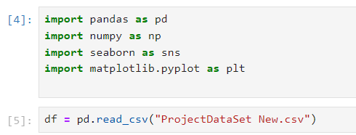
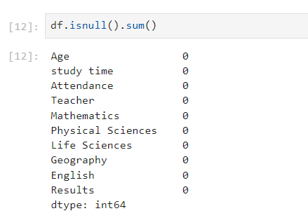
Data Collection and Preprocessing
Data Sources:
Preprocessing Steps
Student performance records (exam scores attendance, teacher ratings).
Demographic information (age).
Subject-specific data (mathematics, physical sciences, life sciences, geography, English).

Slide 4
Machine Learning Model Selection:
Algorithm: Random Forest Model
Why Random Forest?:
High Accuracy
Robust to outliers.
Ensemble of decision trees.
Handling Missing Values.

Slide 5
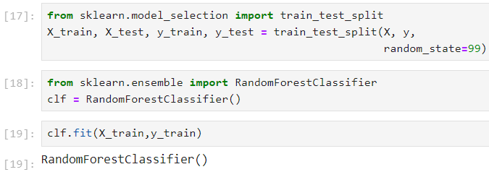
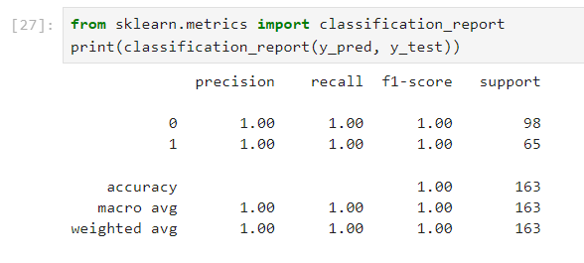
Model Training and Evaluation
Training Data:
Evaluation Metrics

Slide 6
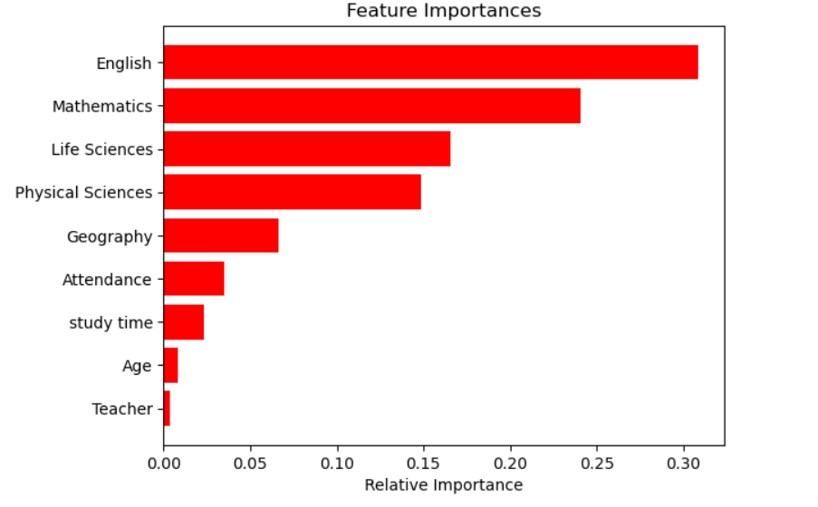
Results and Insights
The Relative Importance of Features graph provides valuable insights into our machine learning model’s behavior. Each vertical bar represents a feature, and its height indicates the feature’s influence on predicting student outcomes (pass or fail).

Slide 7
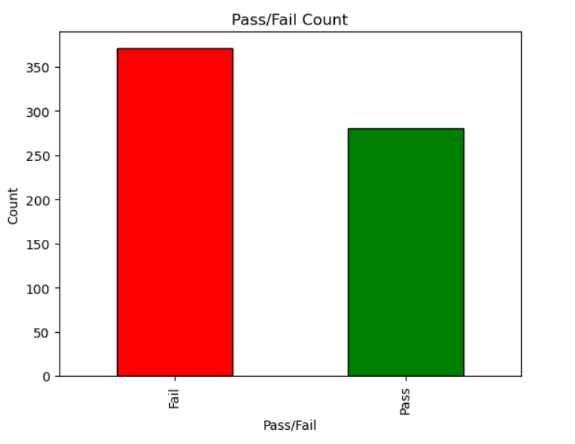
Results and Insights
The graph offers a clear representation of the distribution of pass and fail outcomes, facilitating interpretation and decision-making based on the data.

Slide 8
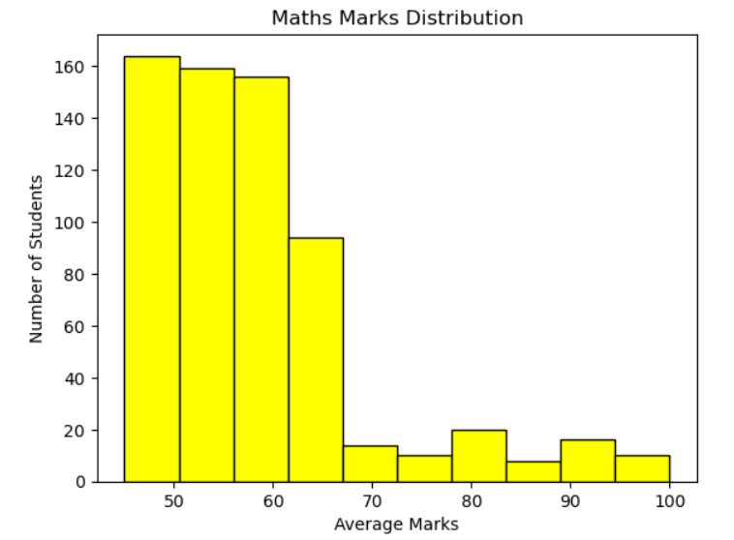
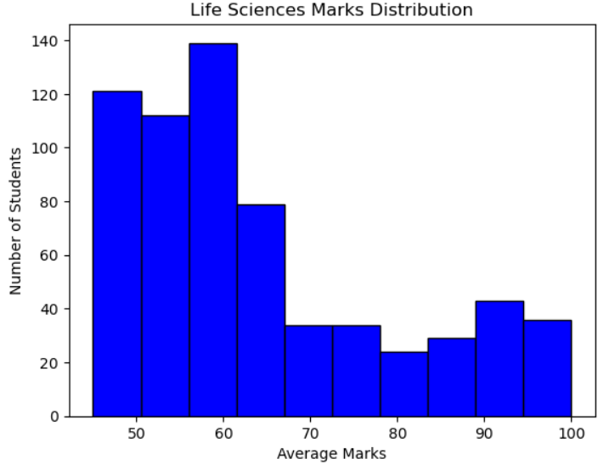
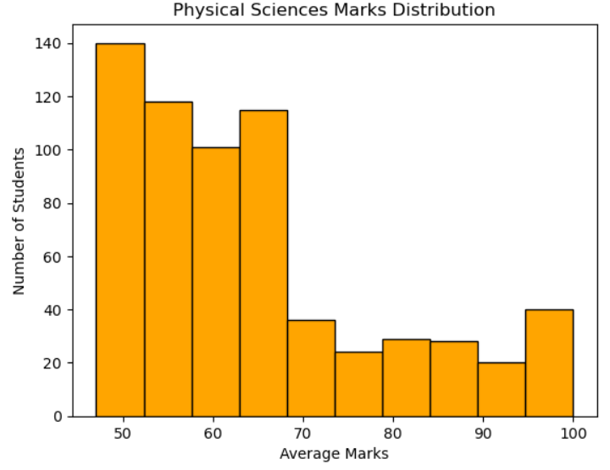
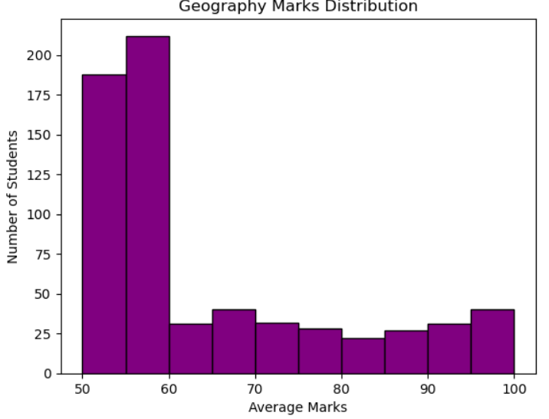
Results and Insights
Marks Distribution Graphs:

Slide 9
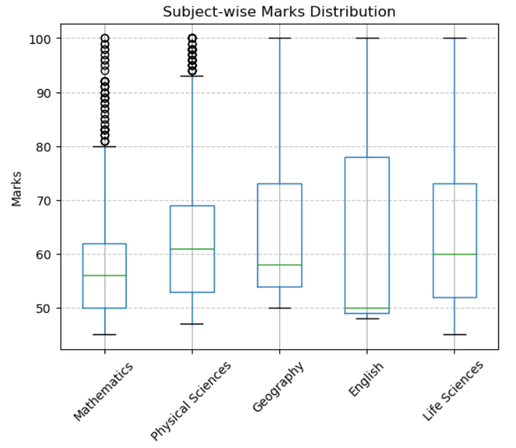
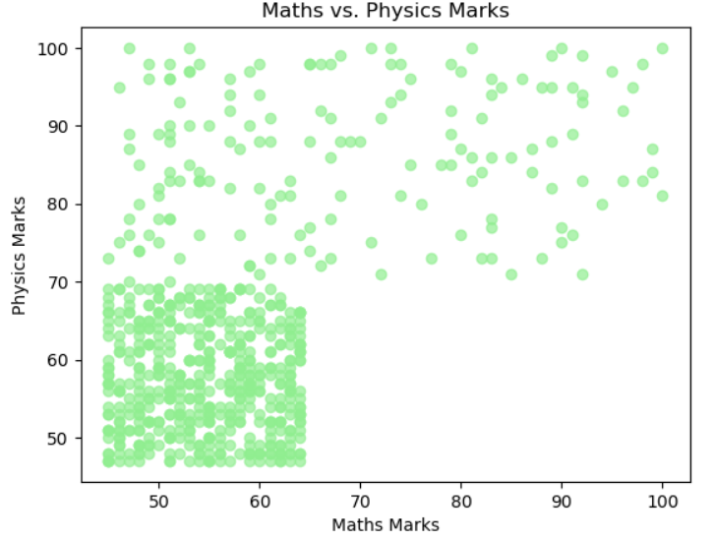
Results and Insights
Subject-wise Marks Distribution
Mathematics vs. Physical Sciences Marks

Slide 10
Conclusion:
In conclusion, the machine learning model presented has demonstrated its effectiveness in predicting student results and providing personalized support. By leveraging the power of data analytics and AI, this solution holds great promise in transforming the educational landscape of the Eastern Cape Province and empowering learners to overcome their challenges and achieve academic success.

Slide 11
Thank You!

